Slide 2
Automating Automation: Build Environments, On-Demand
Josh Steckler
Bose Corporation

Slide 3
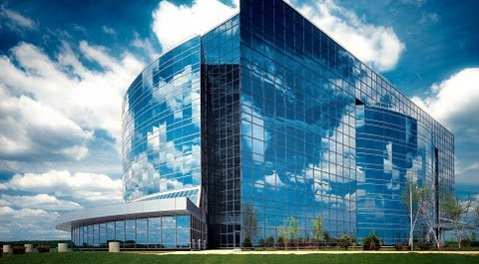
Who am I?
Software Engineer
7 Years at Bose
Scrum Master
Lead for ElectricFlow, JIRA

Slide 4
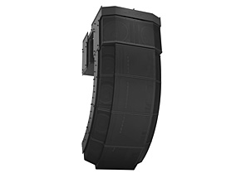

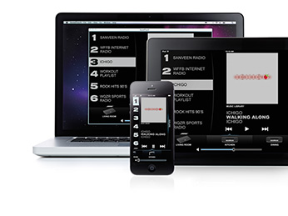
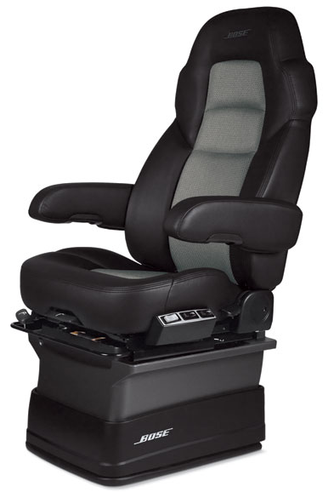
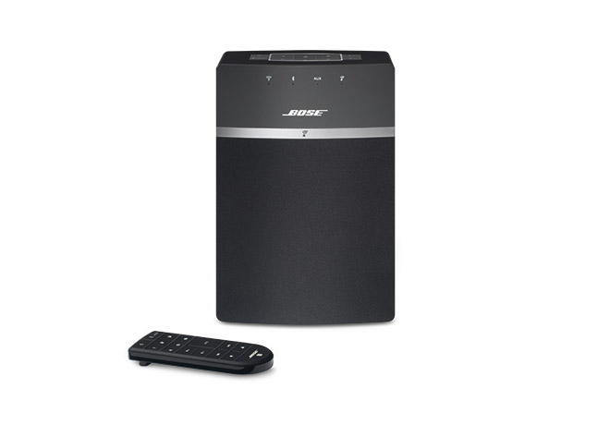
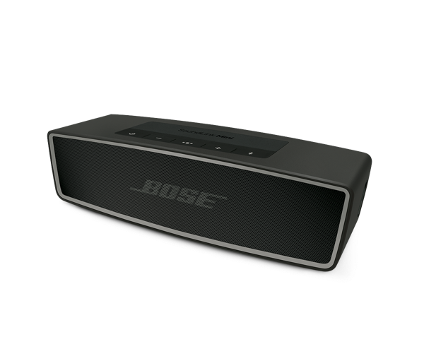
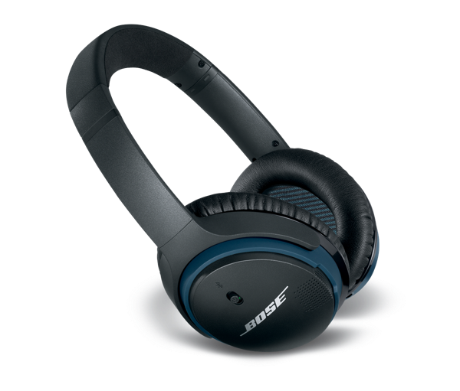

Bose
Based in Massachusetts
51 years
Products come from research
Audio & Non-audio products
Notes:
We are a privately held 51 year old company based in Massachusetts. Our founder was a MIT professor, and he left a legacy of creating products to make people’s lives better. You all know our headphones & wireless speakers etc., but we’ve also developed some things that may surprise you, such as an automotive suspension system and a vibration reducing seat for long-haul truckers.

Slide 5


Bose is Global
x5
Notes:
Although we’re based in Massachusetts, our engineering community is global.
Having such a wide footprint obviously has its challenges. We have people working around the clock.
How do you support engineers in the most efficient way?
How do you work around the time difference?
How do you train users, sites and processes you may never see?
Unfortunately I can’t fix all of these – but automating our processes whenever and wherever we can is a good place to start.

Slide 6





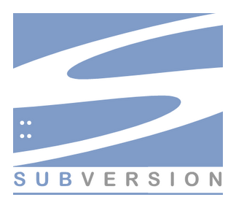

Bose & DevOps
Centralized Engineering Software & Tools Team
Enterprise, integration, automation & Self Service focus
Typically engage for new development, hands off for day to day operations
Notes:
At bose, we’ve centralized our engineering support functions. It has its challenges, but we feel that the centralized approach allows us to provide more value by allowing our product engineers to focus on product development. Since we work in these tools day in and day out, we become experts quickly and we continuously improve our ecosystem with things we’ve learned from each new effort we embark on. There’s challenges of operating like this of course, the chief being the struggle between the whole company’s need to streamline development processes and the individual’s desire to have their environment be exactly what they want, and to control it themselves. You’ve got to find the right balance. We empower people to use self-service whenever we can in an effort to reduce overhead. This allows us to focus more on high-value initiatives. My group provides a full environment from version control, issue tracking, project management, code reviews, static analysis tools and an automation platform.

Slide 7
The Team
3 software engineers, 2 system administrators
Located in HQ, support over 2000 users
Steady headcount with more products developed
In EF: 108 projects, ~3000 jobs/day
Product development focus
Grown from Tool Supporters to DevOps – provide more value
Notes:
Our team is 5 people, and we’re all located in Bose’s corporate headquarters in Massachusetts. In the past five years, the team has had a steady headcount, but Bose’s product output has exploded., We bring more products to market each year now than we ever have in the past.

Slide 8

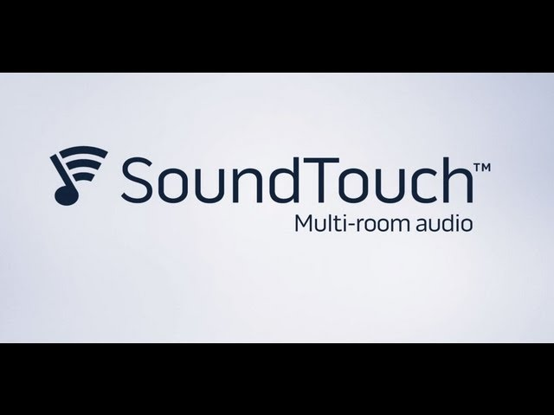
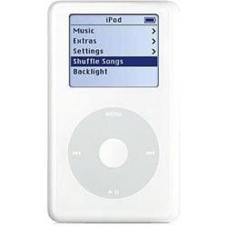



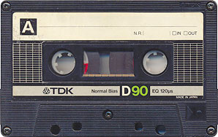







Changing industry = More Software
Notes:
The music industry has, like many others, changed rapidly. It wasn’t too long ago when cars still came with tape decks, even though CDs have been around for quite a long time. But when audio devices like the ipod became popular, the game started to change. Very quickly, we went from having dedicated music devices to, storing the files locally on a hard drive, to using our phones and streaming the music from the internet. Streaming has taken over and there’s so many different choices and variations to keep up with. Spotify only launched in the US in 2011. So, in a matter of a few years, we went from fairly standardized sources, like a CD or a 30 pin ipod connector, to a huge number of variations in devices and services. And the way we actually listen has changed too. I suspect most of us no longer use multi-component systems. We use Bluetooth or other connectivity protocols to control the experience from our phones. The amount of software, and the complexity of the software in our products increased dramatically too.

Slide 9
Product Growth Challenge
How do we support a massive increase in software?
How much would overhead increase?
Needed to revisit our entire environment

Slide 10

Starting Point: Home Grown System
Not scalable, time consuming configuration
Different divisions – different systems
No build status visibility – manual log checking
No job management – failures caused issues
No management UI – hard to learn
Hard to share responsibility

Slide 11
Adoption of Electric Flow
Small pilot project in one division
Gradual, bottom-up viral adoption
Success story shared and adoption spreads to more divisions
Remainder of pilot division migrates to EF
Notes:
Details about the deployment
resonates with engineers

Slide 12
How we got there:
Just get it running – copy & paste existing scripts
Incremental improvements
Automate!
Utilize Advanced Features
Retirement of old systems
Notes:
Did not start with focus on security

Slide 13
First Run
Started with one project, one build resource
No build script changes
Hard coded properties
Comparisons to old system’s deliverables – ensure process is valid

Slide 14
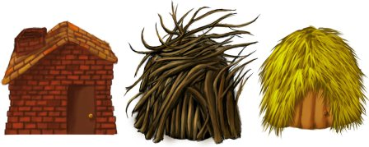
Improvements
Abstract variables into Properties or Parameters
Split existing code into Job Steps
Time based scheduling
Properties – Data Storage, “variables”
Parameters – runtime “arguments”

Slide 15
Procedure Library
Why use a library?
Version Control
Roll out enhancements globally
Change management
Standardization
Examples
Selecting a resource
SVN checkout
Testing (Klocwork)
Deploy to server
Notes:
Version Control – can
Roll out enhancement globally – all changes are instantly applied to all projects
Make it in terms of the story we’re telling – what challenges we had when expanding
We made our library procedures smart enough to handle the same operation on all operating systems

Slide 16
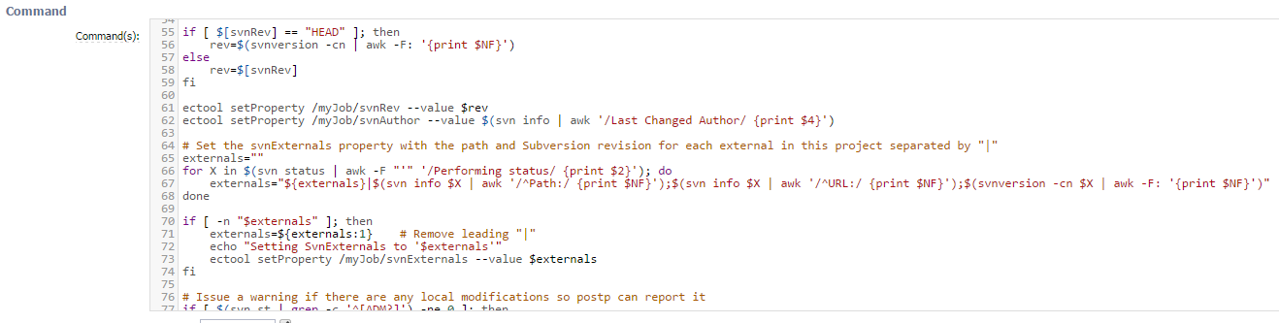
Procedure Standardization

Slide 17
Automate!
Goal: Increase adoption without increasing overhead
Phase One: create new projects
Started by copying and renaming
Permissions issues. Different divisions, different access levels were not implemented
Changing code in several places

Slide 18
Phase Two: “Create Project” Procedure
Self Service – no service ticket required
Utilizes ec-perl API
Default build procedure template
Default properties & parameters set
Set Permissions accurately

Slide 19







A unique system for each vehicle
A3
A6
Audi
A7
A8
Q3
Q7
TT
3.0 Turbo
3.0 Diesel
Tweeter
Woofer
Amplifiers
DSP
Etc.

Slide 20
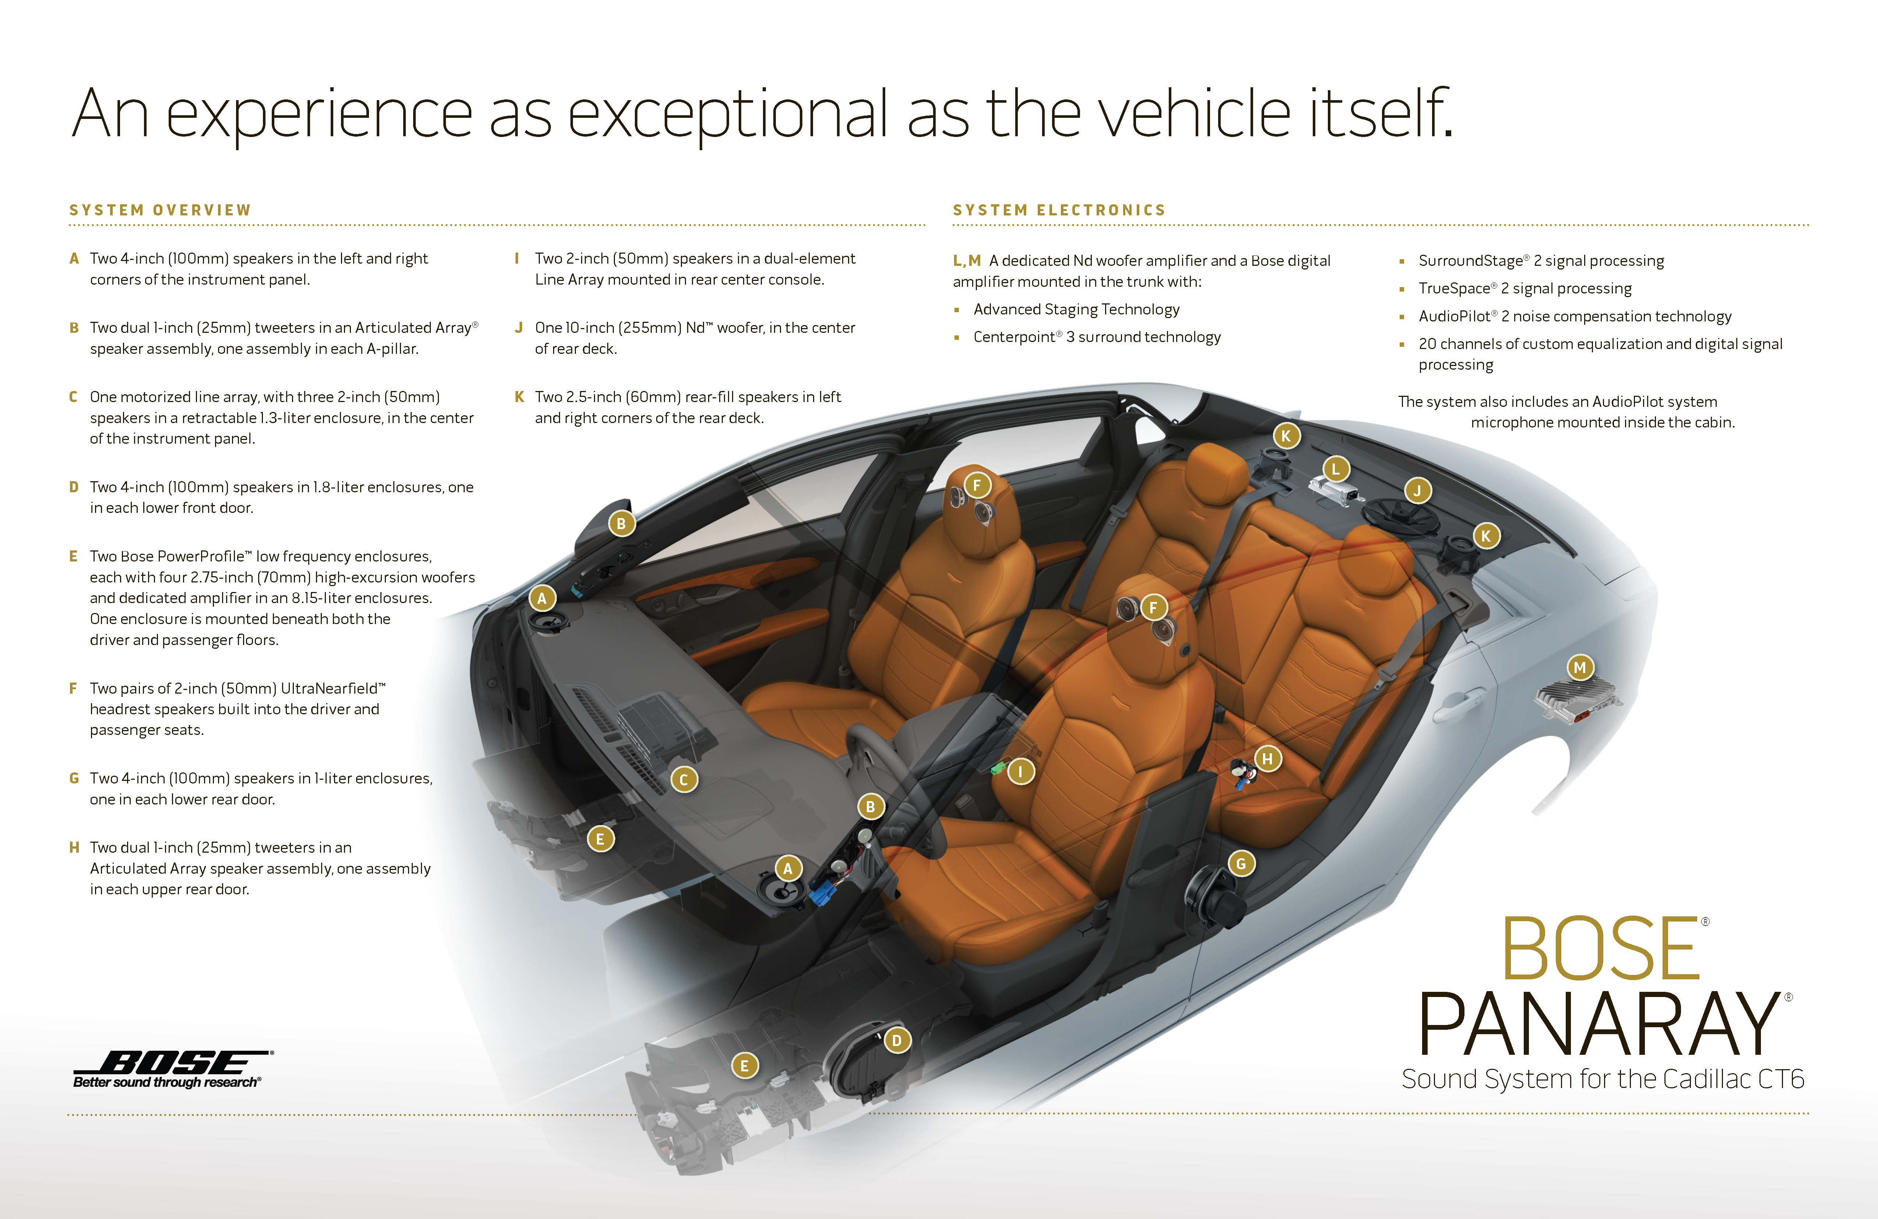
Notes:
Got this from https://globalpressroom.bose.com/us-en/assets/view/8380 it’s public material

Slide 21
Managing Product Complexity
Automotive products have a complex matrix of dependencies
How to make correctly run build?
Phase One: Flexible, but unmanaged build parameter inputs
Error prone
Required specialized syntax, hard to learn

Slide 22
Phase Two: Guided User Input Screen
Easy to learn and use
Able to scale a complex matrix
Don’t allow invalid parameters
Implemented as a Plugin
Version controlled

Slide 23
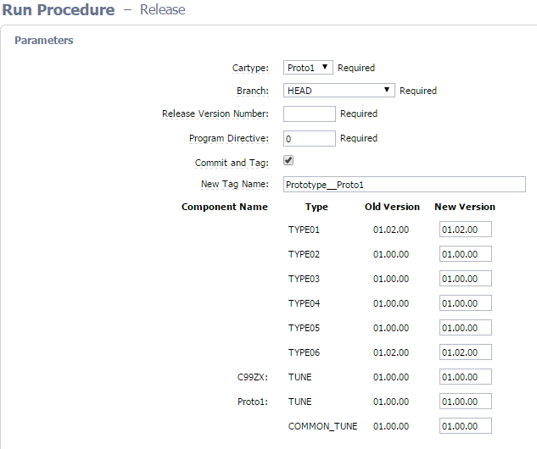
Guided User Input

Slide 24
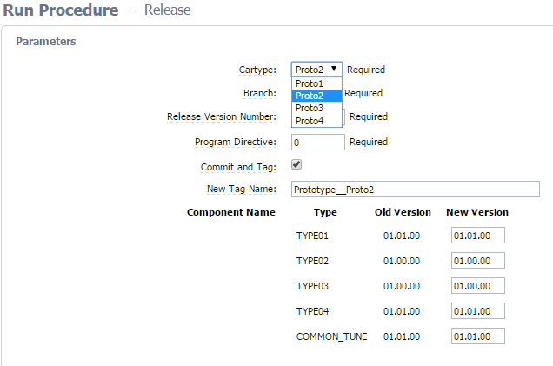
Guided User Input

Slide 25
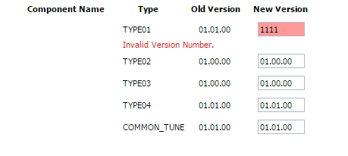
Input Validation - Syntax

Slide 26
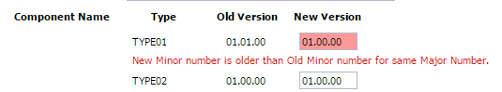
Input Validation - Logic

Slide 27
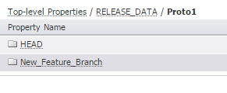
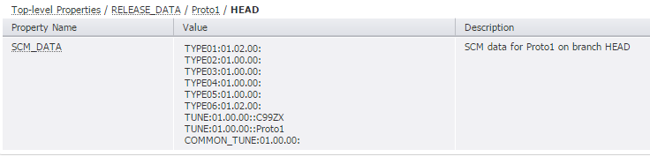
Build Data Management System
Refreshes every 15 mins
Info on build dependencies
Stores data in nested property sheets
Notes:
Management of the data is automated

Slide 28
More Layers of Complexity
Need to run the same process over a variable number of components
Can’t know the right components until runtime
Doing all components too time consuming

Slide 29
Build Steps Unknown
Goal: Build avoidance - handle variable number of changed components
Phase One (considered, never implemented):
Just use a loop in a single step
Hard to report status
Wouldn’t make use of procedure library
Notes:
System won’t let you build with invalid options

Slide 30
Phase Two: Dynamic Jobs
Construct the job at runtime to only build what is necessary, skip the rest
“Metaprogramming” – job transforms itself while running
EF API createJobStep

Slide 31
Outside the Box - Automation Platform
Group has lots of systems to manage
Backups, integrity checks, standard maintenance jobs, etc.
Goal: Take advantage of EF as an automation platform for administrative/IT operations
Notes:
What’s the pain?

Slide 32
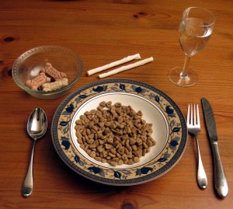
Flow – an IT Automation Platform?
Notifications, reporting, scheduling and resource management
Notes:
Eating our own dogfood

Slide 33
Where are we going?
Integrations with other applications – JIRA
Continue adoption: rest of product development, website group

Slide 34
Thanks!
Questions?
Josh_Steckler@bose.com

